Slide 1
Expected Salary for Data Scientists
ISDS 7070 Group 3
Keilon hill, David Nguyen, Shelby leblanc, hamzah alkhatib

Slide 2
Agenda
The Problem
The Data
The Wrangling
The Results

Slide 3
The Problem
The primary objective of this project is to explore the variables that affect the salaries of data scientists using data from Glassdoor. By accurately estimating salaries and evaluating which attributes most influence salary amount, insights can be provided into salary expectations and trends for data science professionals.

Slide 4

Nuances
Salaries are subjective. Salary amount can be influenced by numerous variables such as location, company size, industry, and job experience, and salary can even vary within the same company or position. The model created must account for these variations to make accurate predictions.

Slide 5
Success Measurement
Mean Absolute Error
Mean Squared Error
MAE provides a straightforward interpretation of prediction accuracy and is less sensitive to outliers.
MSE penalizes large errors more heavily due to the squaring operation, indicating how close the model’s predictions are to the actual salaries.

Slide 6

Assumptions
-Data Representativeness: The dataset from Glassdoor is a fair representation of real-world salary distributions for data scientists.
-Consistent Salary Patterns: The patterns influencing salaries remain relatively consistent during the time covered by the dataset.

Slide 7

Verification
-Cross-Validation: After splitting the data into training and validation sets, we will use techniques like k-fold-cross validation to verify the performance of the model
-Holdout Validation: We will reserve a portion of the data for final model evaluation
-Time-Based Validation: If the dataset has a temporal component, we can simulate real-world scenarios by training on older data and validating on more recent data

Slide 8
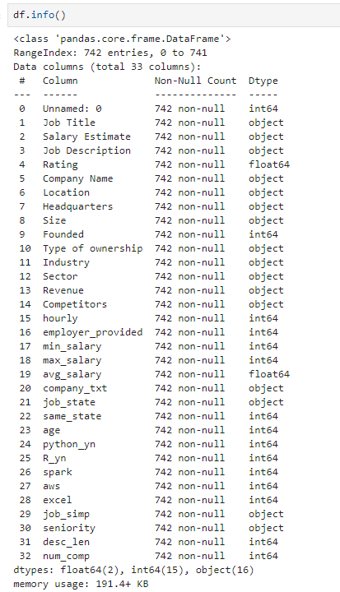
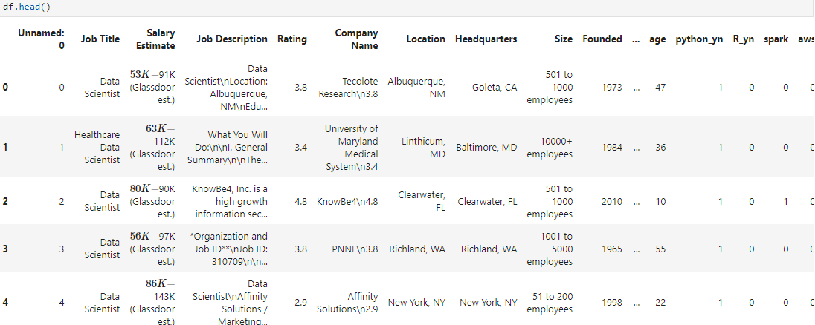
Original Dataset
742 non-null values
32 columns
Floats, integers, objects

Slide 9
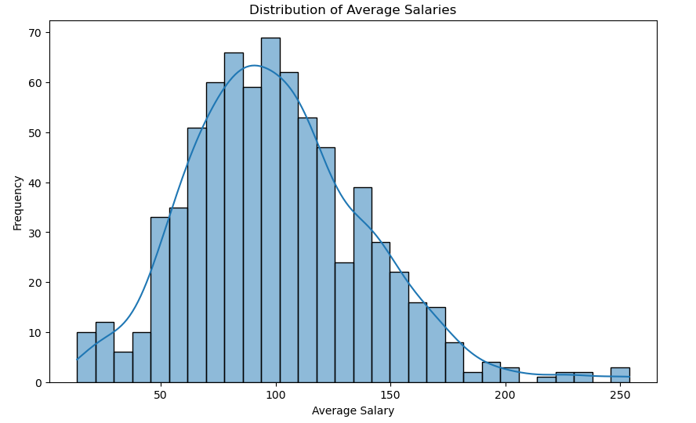
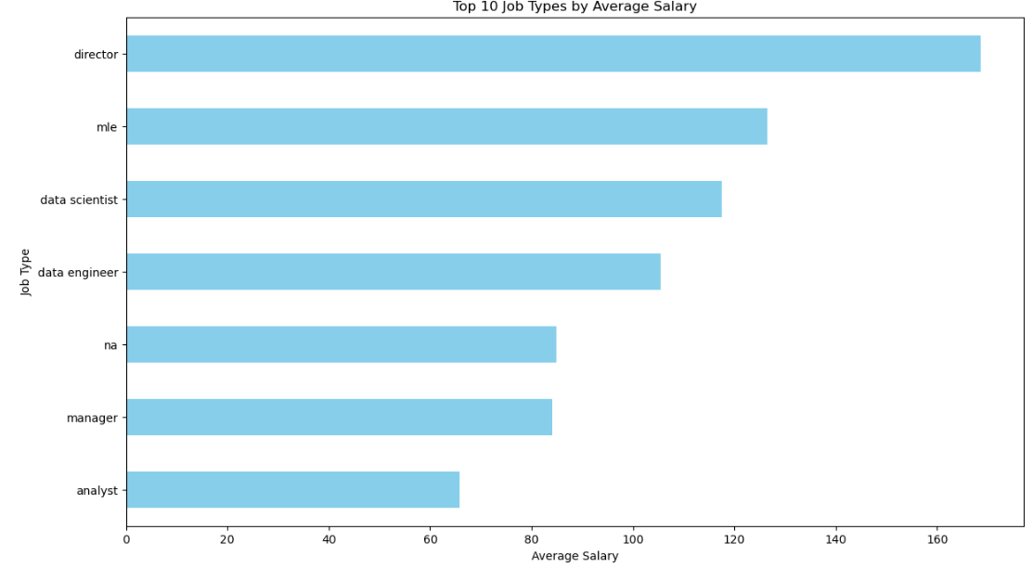
Data Exploration
Distribution of Average Salaries
Top 10 Job Types by Average Salary
Notes:
Based on the initial import of the Salary Data, the distribution of average salaries is skewed to the right. Many factors could explain the skew; however, the average salary looks like it has high outliers.
Based on the top 10 simplified job types, Directors, Engineers, and Scientists have the highest average salaries. These job types are typically expected to have more responsibilities and require more expertise, therefore probably require higher salaries.

Slide 10
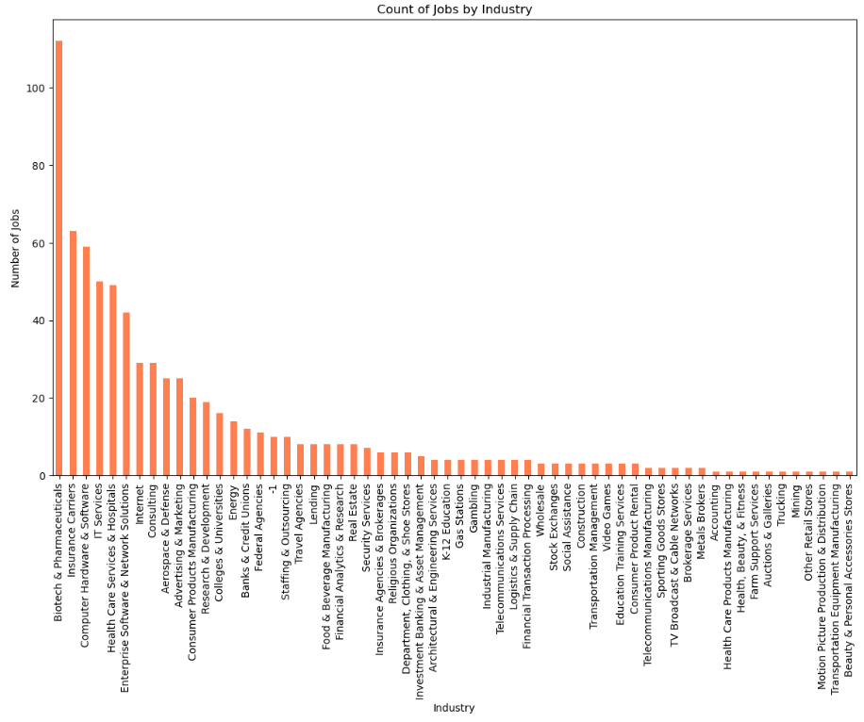
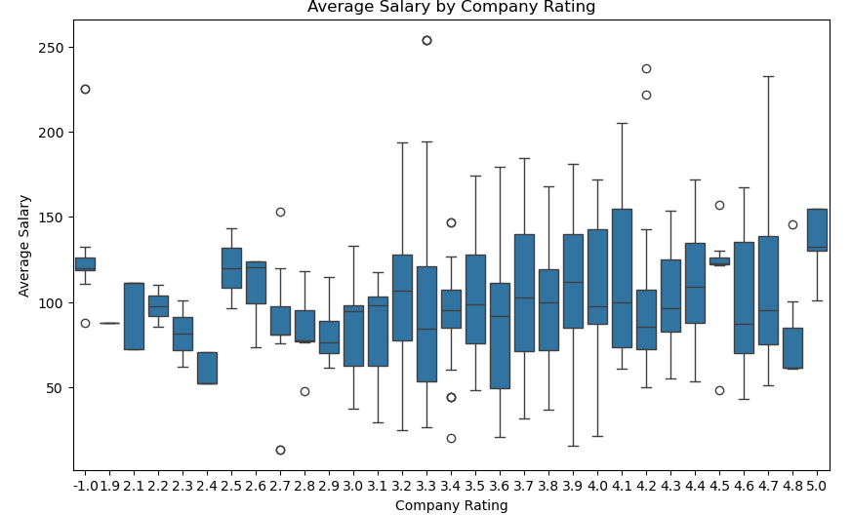
Average Salary by Company Rating
Count of Jobs by Industry
Notes:
The Seaborn boxplot for salaries based on Company rating identifies outliers in the dataset and shows that companies rated between 3.3 and 4.7 have the largest salary ranges.
This dataset includes information on jobs mostly in the Biotech/Insurance,and IT realm, which will make the findings of our model skewed toward these industries. A Data Scientist looking for a job in Arts/Galleries will not find the model we are developing to be as useful as one searching in the industries most represented in this dataset.

Slide 11
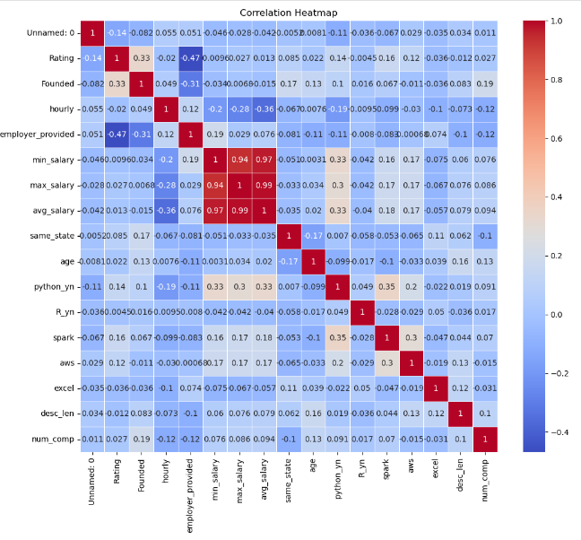
Correlation Heatmap
Notes:
In reviewing the Correlation Heatmap, there is a slight positive correlation between experience, such as Python, and the average salary.

Slide 12
Data Wrangling Overview
Dataset: Glassdoor salary data for data scientists
Objective: Preparing data for accurate salary predictions
Key Steps:
Cleaning salary estimates
Handling missing values
Encoding categorical variables
Feature selection and scaling

Slide 13
Data Cleaning and Transformation
Cleaning Salary Data:
Custom function to extract and clean salary estimates
Handling Missing Data:
Dropped rows with missing values
Feature Engineering:
Ordinal encoding for categorical variables (e.g., job title, company size)
Transformation of company size and revenue into numerical values

Slide 14
Final Data Preparation and Standardization
Feature Scaling:
Standardized features using StandardScaler
Dimensionality Reduction:
Applied PCA to select top features
Outcome:
Prepared data for accurate and reliable model predictions

Slide 15
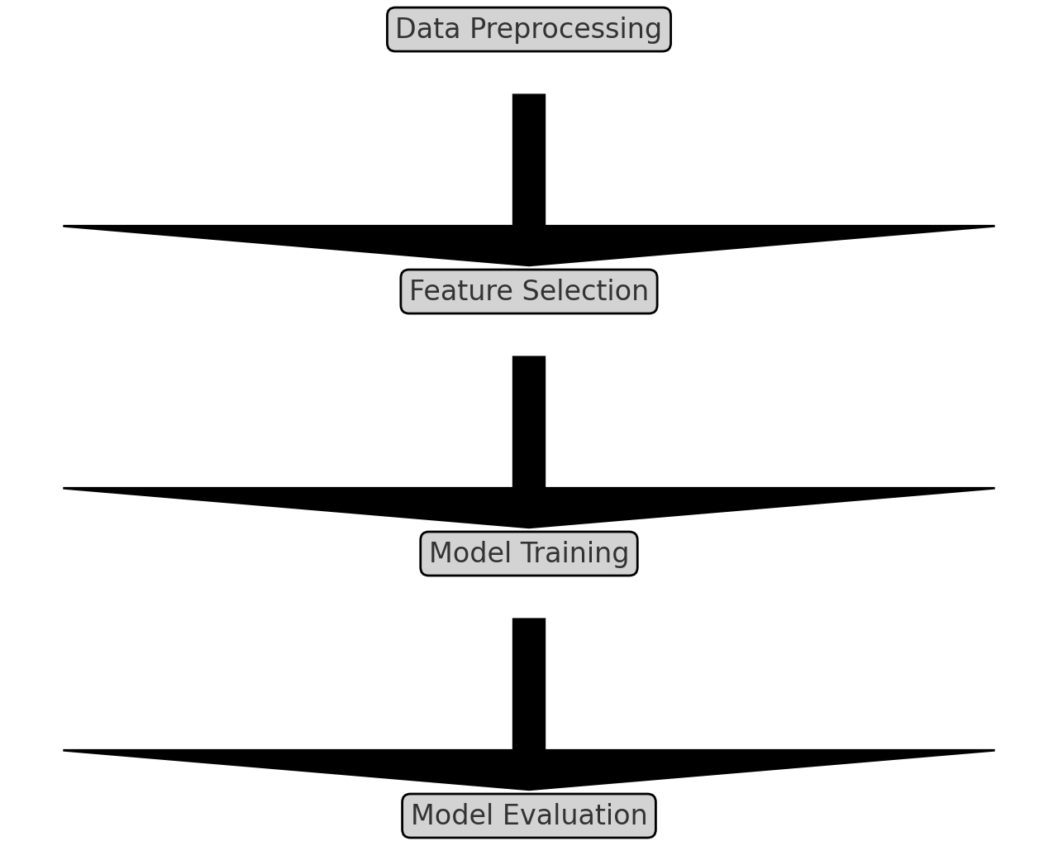
Modeling Overview
- Objective: Predicting data scientist salaries using machine learning
- Key Steps:
1. Data Preprocessing
2. Feature Selection
3. Model Training
4. Model Evaluation

Slide 16
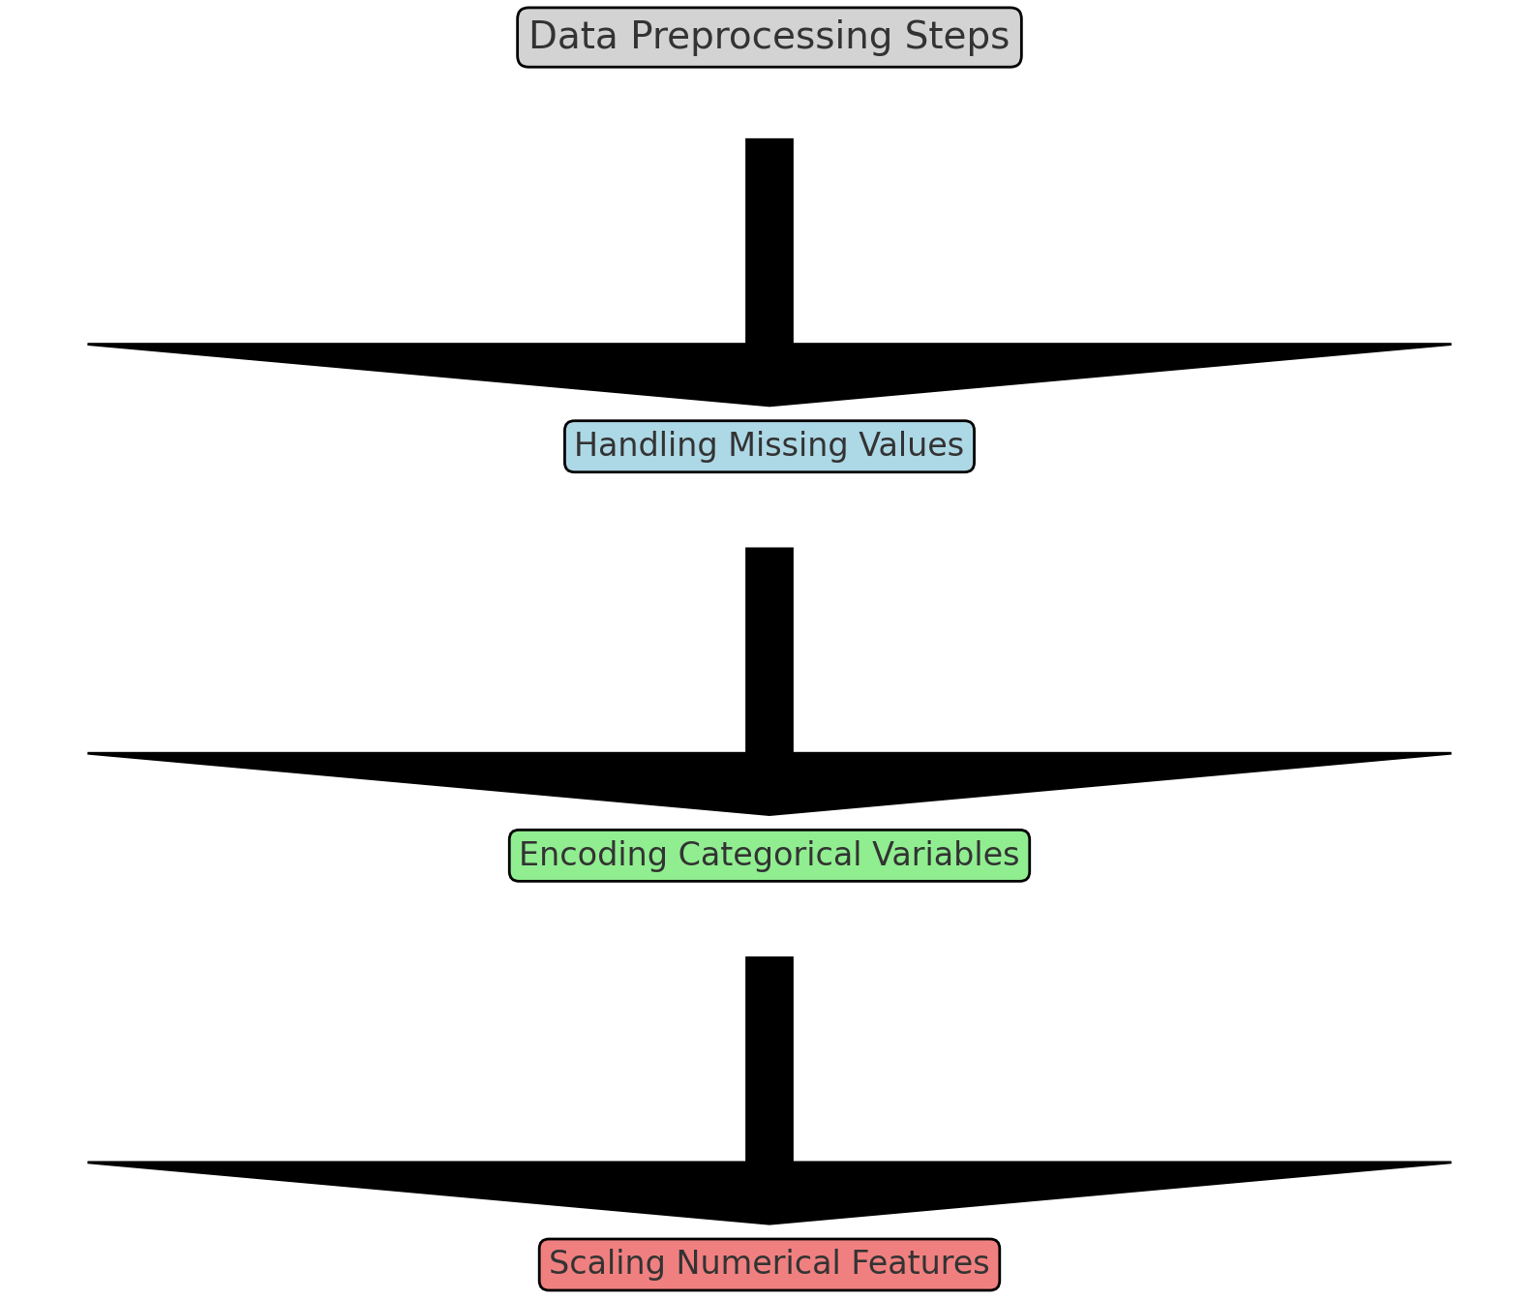
Data Preprocessing
- Handling Missing Values: Imputed or dropped
- Encoding Categorical Variables: Encoding for categorical features
- Scaling Numerical Features: StandardScaler used to normalize numerical features

Slide 17
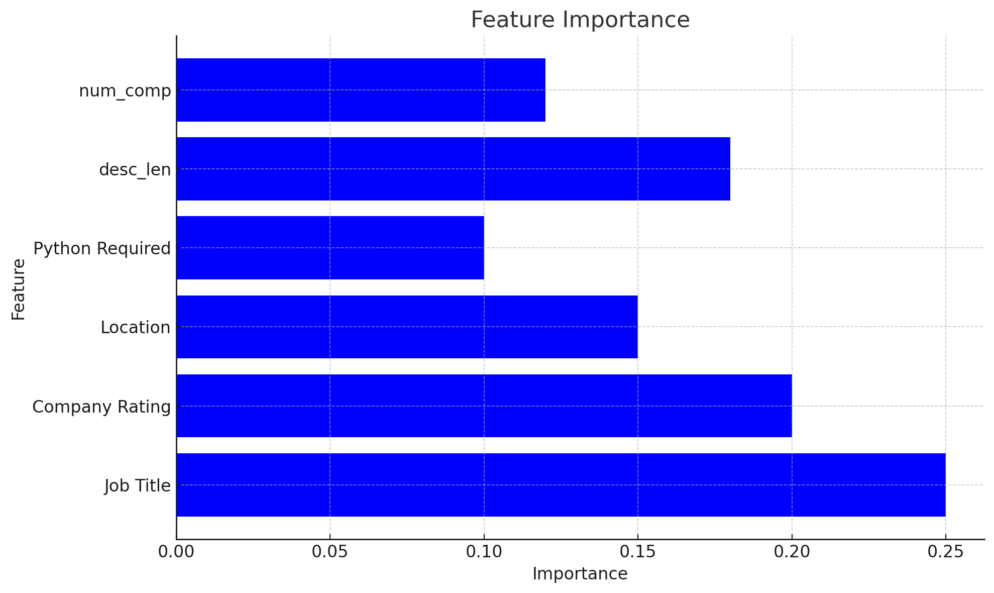
Feature Selection
- Initial Features: Job Title, Company Rating, Location, Company Size, etc.
- Selected Features: Job Title, Company Rating, Location, Python Required, etc.
- Feature Importance: Calculated using feature importances from the model

Slide 18
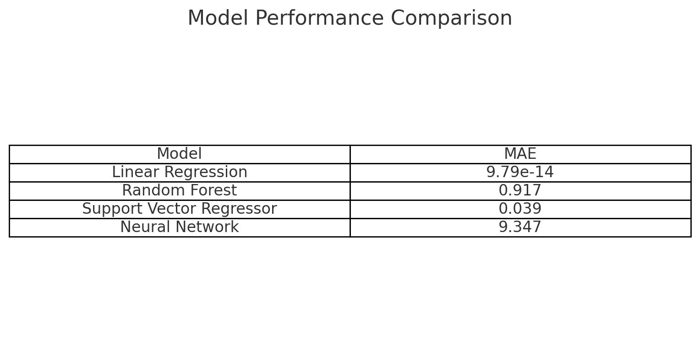
Model Training and Evaluation
- Evaluation Metrics: Training MAE, Validation MAE
Linear Regression: Training MAE:1.2×10−14 Validation MAE: 9.787×10−14
Random Forest: Training MAE: 0.88 Validation MAE: 0.917
Support Vector Regressor: Training MAE: 0.035 Validation MAE: 0.039
Neural Network: Training MAE: 9.0 Validation MAE: 9.347
- Training Set: 70% of data
- Validation Set: 30% of data
- Cross-Validation: 5-fold cross-validation used to tune hyperparameters

Slide 19
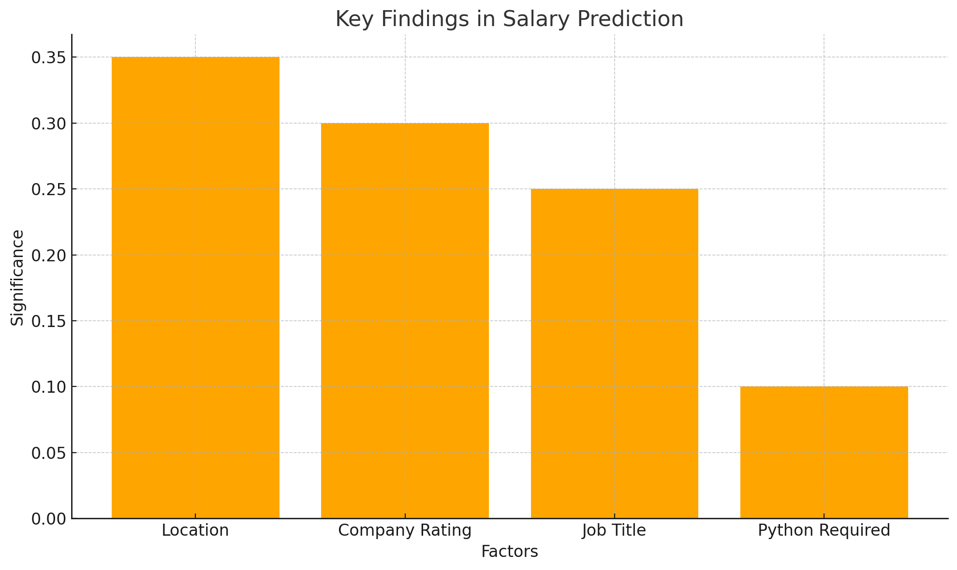
Results Summary
- Model Performance: Achieved an MAE of 9.787x-14 on the validation set
- Key Findings: Location and Company Rating are significant predictors of salary
- Implications: Helps in understanding salary trends and expectations for data scientists

Slide 20
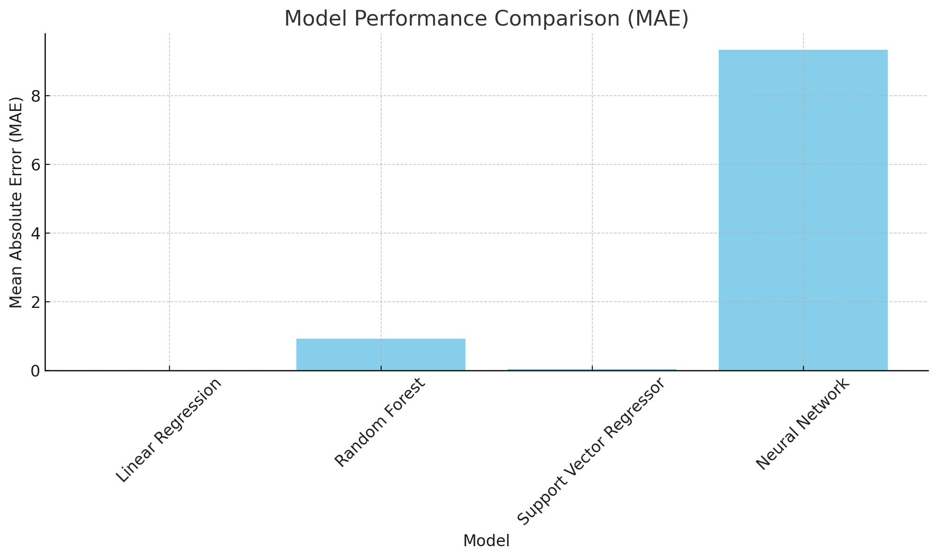
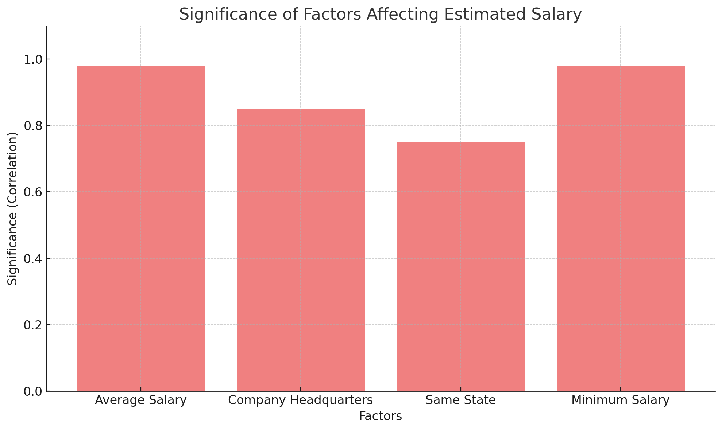
Conclusion
- Summary of Findings: The model effectively predicts salaries with reasonable accuracy
- Future Work: Incorporate more features and explore different modeling techniques for improved accuracy

Slide 21
Data Set [Kaggle]
TheDevastator. (n.d.). Jobs dataset from Glassdoor [Data set]. Kaggle. https://www.kaggle.com/datasets/thedevastator/jobs-dataset-from-glassdoor

